Slide 1
PPS STRINGS
SEMESTER:1ST SEM
PREPARED BY: Divya kushwah

Slide 2
Chapter 4 –ARRAY & STRING
Outline
Introduction to string
Declaration and Initialization string variable
Reading strings from terminal
Writing strings to screen

Slide 3
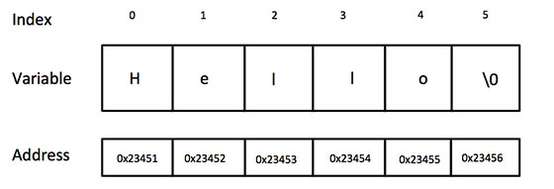
Introduction to strings
A string is a sequence of character that is treated as a single data item.
Strings are actually one-dimensional array of characters terminated by a null character '\0’.
Thus a null-terminated string contains the characters that comprise the string followed by a null.
Character string are often used to build meaningful and readable program.
Common operation are:
Reading and writing string
Combing string
Copying one string to other
Comparing string for equality
Extracting the portion of string

Slide 4
Declaration of the string
The general form of declaration of the string variable is:
char string_name[size];
The size determine the number of the character in the string_name.
For example;
char city[10];
char name[30];
The compiler automatically supplies character (‘\0’) at the end of the string.
The size should be equal to the maximum number of character in the string plus one.

Slide 5
INITIALIZATION of the string
In C programming language, a string can be initialized at the time of declarations like any other variable in C.
If we don't initialize an array then by default it will contain garbage value.
Like numeric arrays, character arrays may be initialized when they are declared.
C permits a character array to be initialized in either of the following ways:
char city [9] = “ NEW YORK”;
char city [9]={‘N’,’E’,’W’, ‘Y’,’O’,’R’, ‘K’, ‘\0’ };
C also permits us to initialize a character array without specifying the number of elements.
In such cases, the size of the array will be determined automatically, based on the number of elements initialized.
char city [ ]={‘G’,’O’,’O’, ‘D’, ‘\0’ };
It defines the array string as a five element array.

Slide 6
READING STRING FROM TERMINAL
The familiar input function scanf can be used with %s format specification to read the string of character.
The scanf function automatically terminate the string that is read with the null character.
The character array should be large enough to hold the input string plus the null character.
The ampersand(&) is not required before the variable name.
Example:
char address[10]
scanf(“%s”, address);

Slide 7
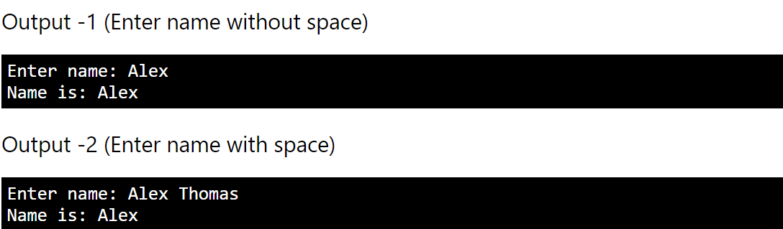
example
#include <stdio.h>
int main()
{
char name[30];
printf("Enter name: ");
scanf("%s",name);
printf("Name is: %s\n",name);
return 0;
}

Slide 8
Reading the line of text
Scanf with %s or %ws can read only strings without whitespaces.
They cannot be used for reading a text containing more than one word.
C support a format specification known as the edit set conversion code%[..] that can be used to read a line containing a variety of character, including whitespaces.
char line [80];
scanf(“%[^\n]”, line);
printf(“%s”, line);
this program segment will read line of input from the keyboard and display the same on the screen.

Slide 9
GETCHAR
Getchar()- this function is repeatedly to read the successive single characters from the input and place them into a character array.
The entire line of text can be read and stored in an array.
the reding is terminated when the new line character is entered and the null is inserted at the end of the string.
The getchar function has no parameters.
Example:
char ch;
ch = getchar();

Slide 10
GETs
Another method for reading a string of text containing whitespaces is to use the library function gets available in the<stdio.h> header file.
This is simple function with one string parameter.
gets(str);
Str is a string variable declared properly.
It read the character into str from the keyboard until the new line character is encountered and then append the null character to the string.
It do not skip whitespaces.
Example:
Char line [80];
Gets(line);
printf(“%s”, line);

Slide 11
Writing string to screen
the printf function with %s format to print strings to the screen.
The format %s can be used to display an array of character that is terminated by null character.
Example:
Print(“%s”, name);
Can be used to display the entire content of the array name.
puts() can be preferred for printing a string because it is generally less expensive and if the string has formatting characters like ‘%s’, then printf() would give unexpected results.

Slide 12
example
// C program to show the use of puts
#include <stdio.h>
int main()
{
puts(“hello");
puts(“helloworld");
getchar();
return 0;
}

